Slide 1
Python: Replacing java to reduce redundancy
Thomas Norman

Slide 2
Project Scope
The originally intended purpose of this project was to, not only learn python as a new programming language, but to use it with other languages and see how they interact with, compliment and even out preform one another. My original scope was to create a student registration system that simply shows the process of selecting classes where the system will dictate how many more class hours a student may select at a time.
For this specific program, I originally created a database with several students and schedules, however, I ended up scaling it back to simply focus on the main functions and show a side by side analysis of how Python could better preform these actions in terms of redundancy and syntax creation time.

Slide 3
A few Basics…
Java Vs.
Python
Static – Declared variables
Required class creation for programs
Even with class extensions, constructors must be defined explicitly
File I/O requires several imports and exceptions for one small file to be read
Most basic functions are built on words and collections that aren’t always necessary
Dynamic – No declaration
Instant code creation, no class needed
No need for explicit definitions if class is extended
To read a file, the file as an object is defined, and the contents are printed.
The build of all main functions is concise and only contains necessary parts

Slide 4
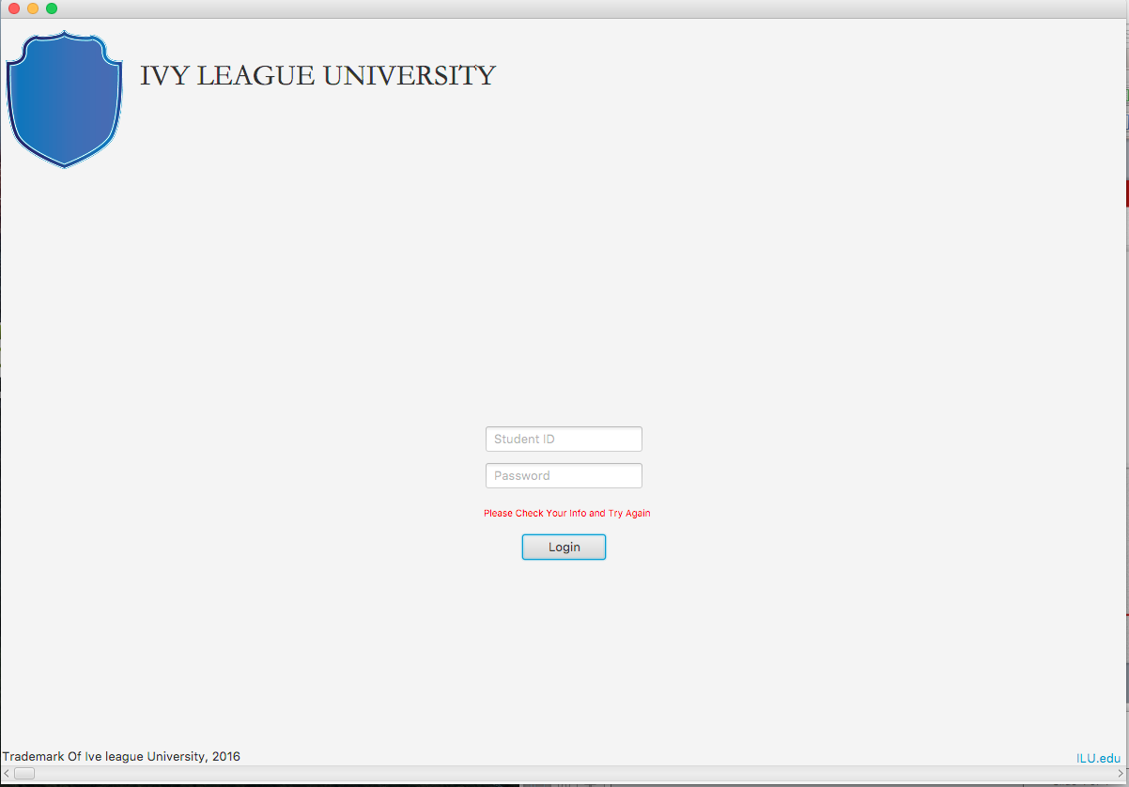
The Login Screen
First, we are presented with a simple login screen. It accepts the Username and password, connects to a small database to match it and either allows permission or denies based on the match. To the Right we see where it is denying the user Permission.

Slide 5
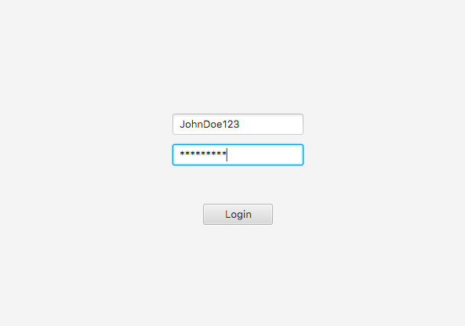
For the purpose of this exercise, I used the database info
To call our user JohnDoe123, and have a Password of Password1

Slide 6
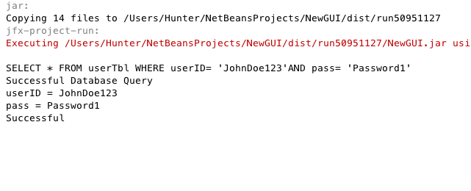
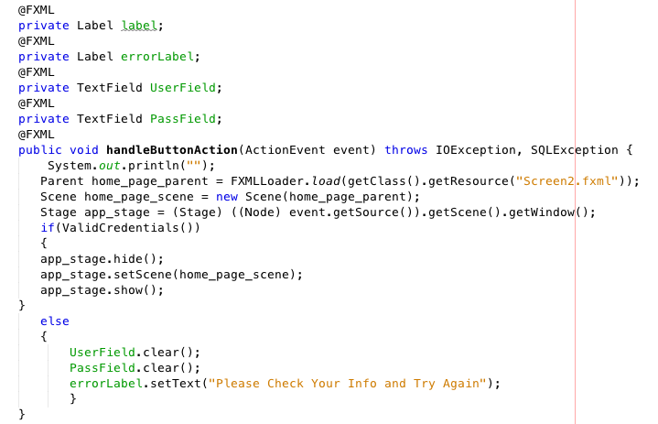
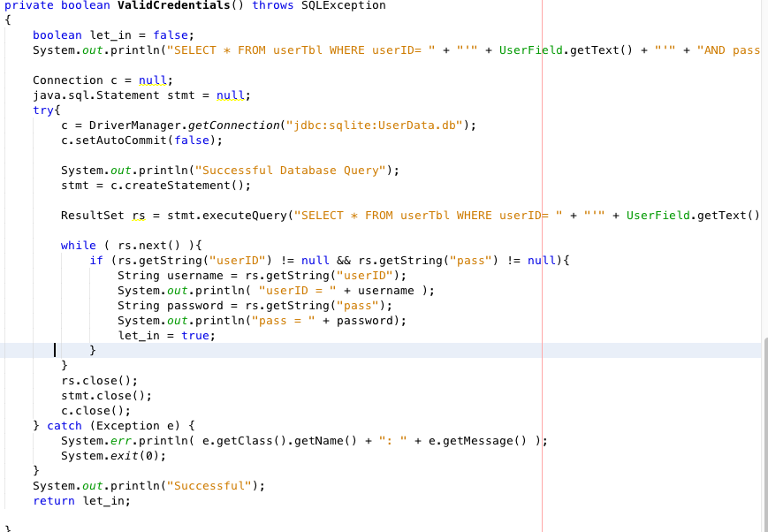
Code thus far…
I’ve created this first output command set to show that the database ‘userTbl’ was accessed and the correct schema was selected, resulting in a successful Match.
The Following examples show the code used to declare variables and match within the database.

Slide 7
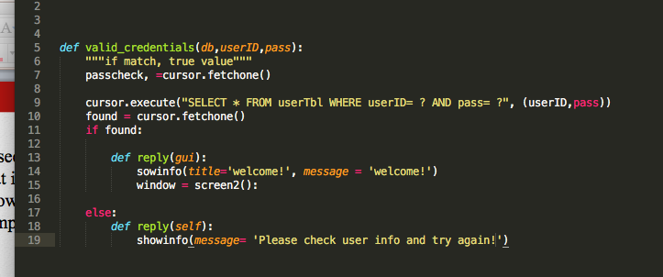
As seen in the previous slide, there is a healthy amount of code, while fairly basic
That is used to check the input against the database schema, match it and either
Allow the user in or print an error message. The following screenshot shows a
Comparable method in Python:
Aside from creating the GUI files (FXML in this case), this method checks the info with the database, creates a parsing cursor to match and either allows or denies the user

Slide 8
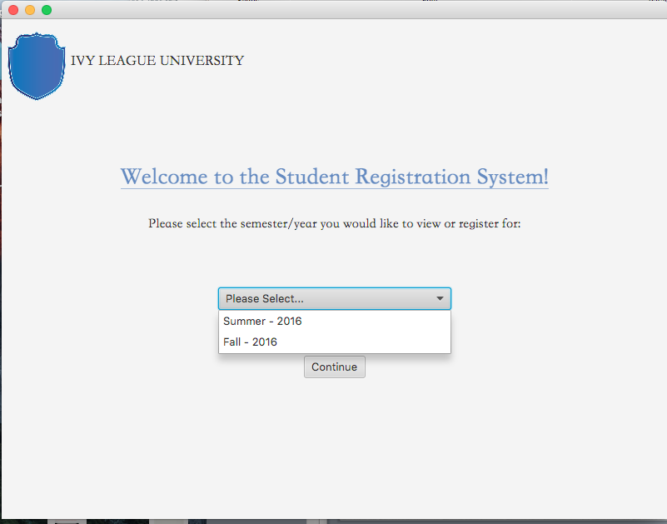
Semester Selection Screen

Slide 9
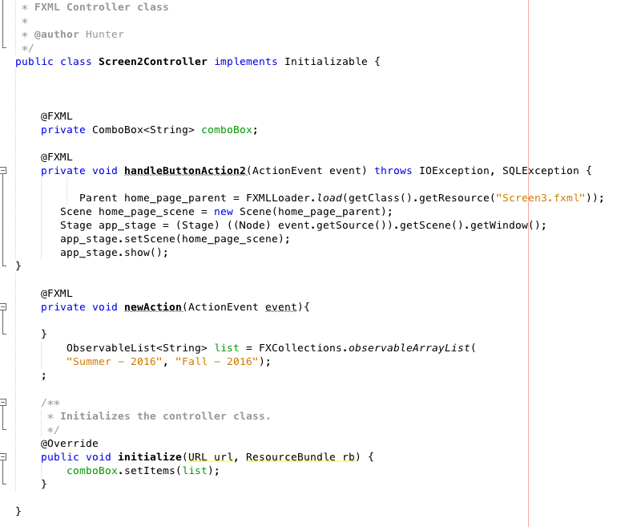
The semester selection screen consists of several labels, one dropdown box and one main button. In java, the entire GUI and all functions, collectively, is fairly light on the code:

Slide 10
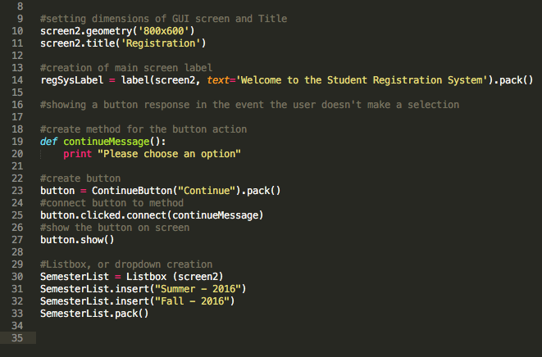
In Python, however, the creation of the button, the drop down and their respective functions are much simpler, even for a small process. The below image shows the creation of the frame and the components.
Though the lines of code are not very different, the amount of syntax is greatly reduced with python

Slide 11
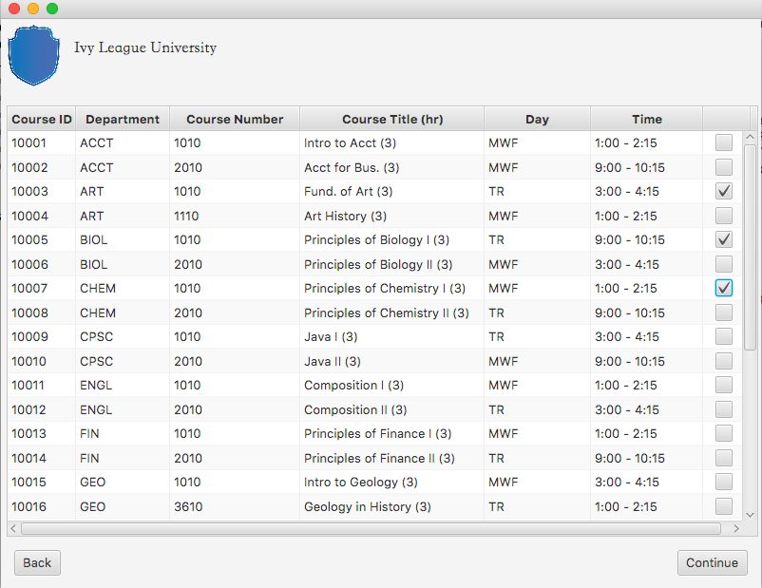
Class List

Slide 12
This slide, regardless of the programming language, is the most dense of the application as it contains a table (TableView for FXML, in this case) that houses the class list including the course ID, department, CRN, course title and credit hours, day and time. Also worth mentioning, there is a column with checkboxes to correspond to the student’s selection of classes. For the sake of this project all classes in this list are 3 credit hour classes, the current student user has already registered for 3 classes and the maximum amount of allowed hours is 18. Therefore, the student may only select 3 of these checkboxes. Any more, and the user cannot move forward in the process.
For the sake of length, I will use the next few slides to go over the java code snippets that relate to the previous screenshot.

Slide 13
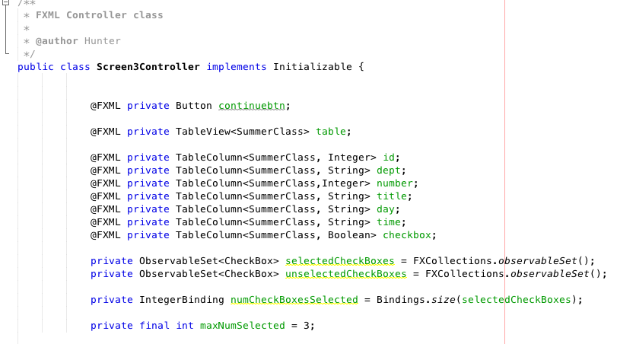
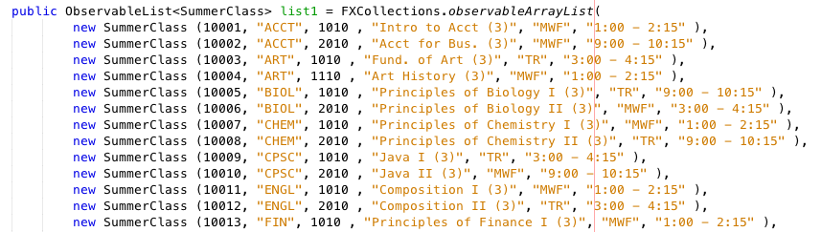
← Declarations
Observable List for
Table Data →

Slide 14
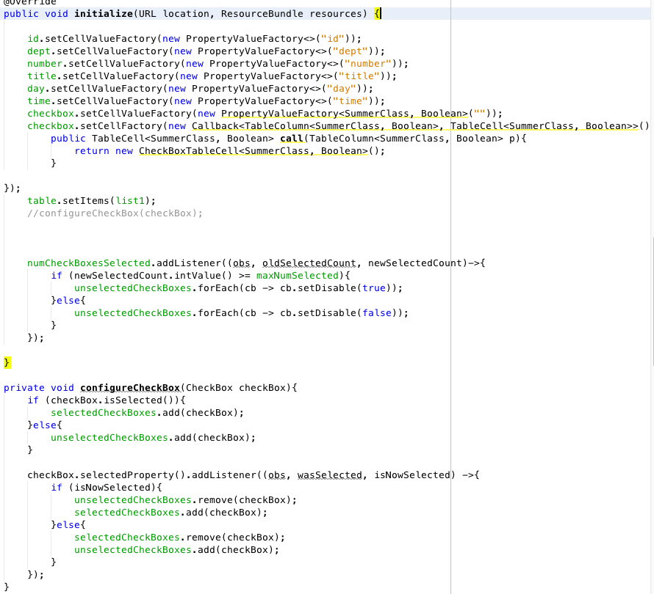
Initializing Controller
And checkbox response →

Slide 15
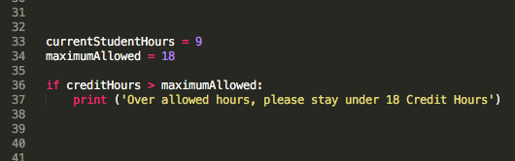
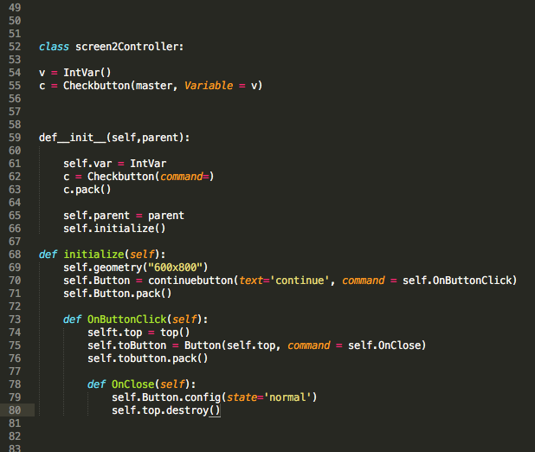
Though the Java code contains a lot of information regarding the table, lists, and the GUI itself, there are only a few sections for commands. While the java version is based upon the amount of checkboxes clicked, a simple way to use python in order to calculate the allowed hours based upon the users’ info would be:
To the right, there is a more generalized version of the button action and the checkBox definition

Slide 16
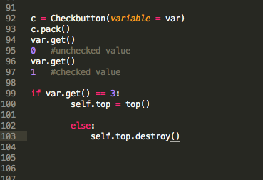
One of the final methods of the project is the acceptance of the selected checkboxes. In Java, this has to be done by declaring the checkboxes in the table column and setting the selection as a new data item. This would then need to be declared as a variable that can be used by a method using an if statement regarding the checked or unchecked state. This involves several declarations and methods. However, in Python, the states of the checkbox can be instantiated by variables like so:

Slide 17
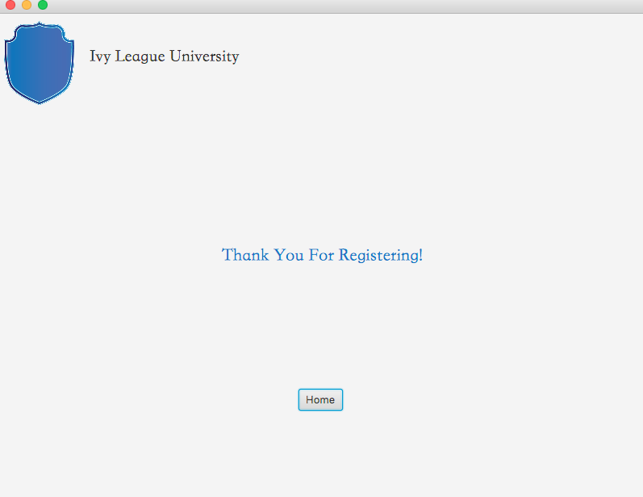
This syntax allows us to easily declare the states of the checkbox and create our if statement that will check the integer value of boxes checked to allow us to the final scene.

Slide 18
So, it is easy to see, even from the few basic methods involved in this application, that Python puts much less strain on the coder than java might under certain circumstances. The fact that no declaration is necessary in python automatically reduces the amount of syntax needed just to begin coding in Java. I believe Python Is actually a great language to begin on and I truly wish I would have been able to start with it. It’s become more complicated for me to recursively tear apart java code and figure out how to apply it to python, simply because I’ve become so used to the labor intensive defining and declaring involved. Of course, this reduction of code time and syntax leads to much less strain on the CPU and less time for the build/clean of the application as well.
There is one key disadvantage to Python, which is the fact that it is much less portable. Java can preform on multiple platforms, usually inherently, but Python needs a dedicated program to compile and build. Therefore, I think Python is great for supplementing text editing and simple methods in programs that are based in other dynamic languages. Python, if used properly, is a great compliment to Java for applications that use as much text input and output as graphics and events.

